Slide 1

Crop yield management and prediction by analyzing environmental data
Presented by- Group 2
Arun Pratap Tomar - 11652000
Namratha Modalavalasa - 11652002
Padmaja Kodati - 11647780
Rikhita Koganti - 11641222

Slide 2
Content
Diagrams
Workflow
Tool
2.1 Google colab
2.2 PySpark
2.3 Cassandra
Methodology
3.1 Importing the data and creating dataframes and tables
3.2 Executing different queries
3.3 Merging the data
3.4 Preprocessing of data
Visualization of data
Machine Learning Implementation

Slide 3
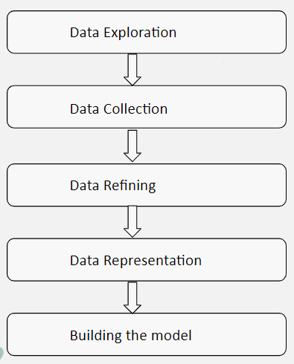
WorkFlow of Solution

Slide 4
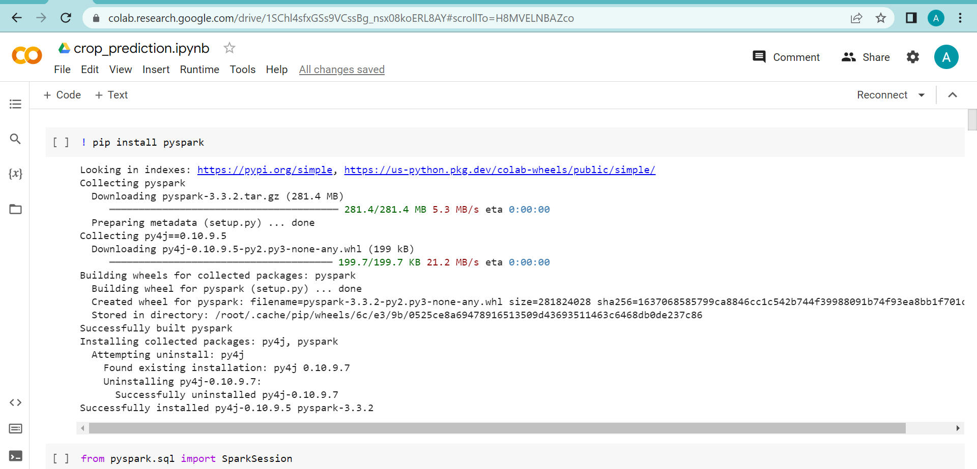
Tool
Google Colab

Slide 5
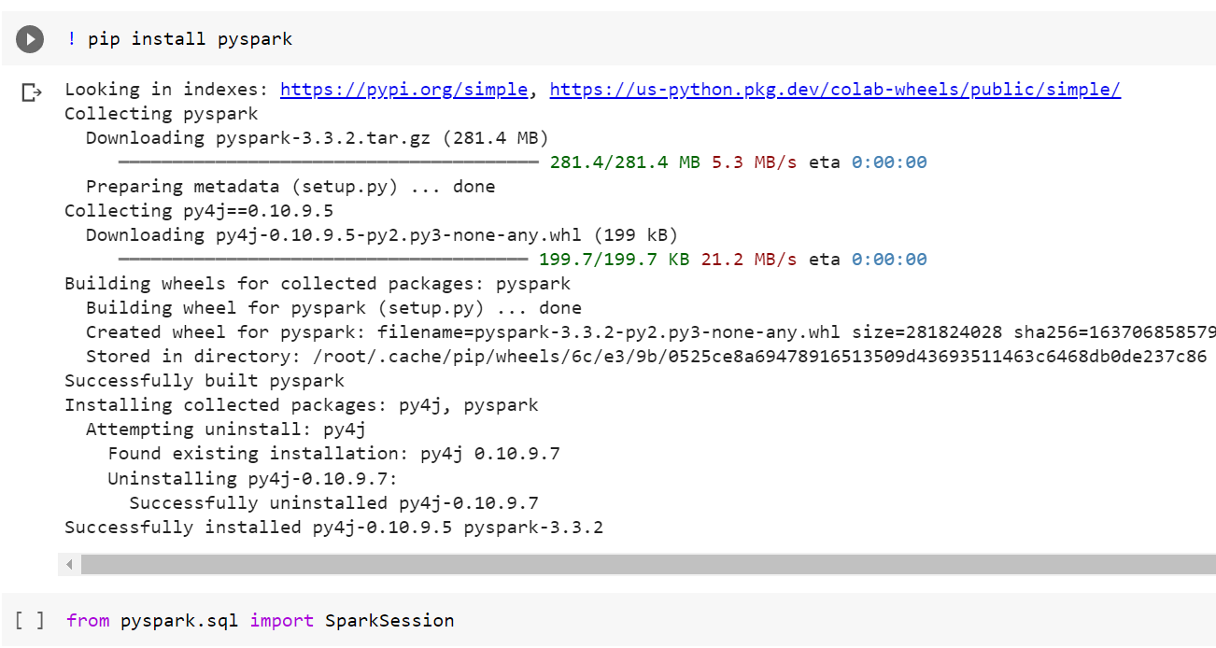
Tool
2. PySpark

Slide 6
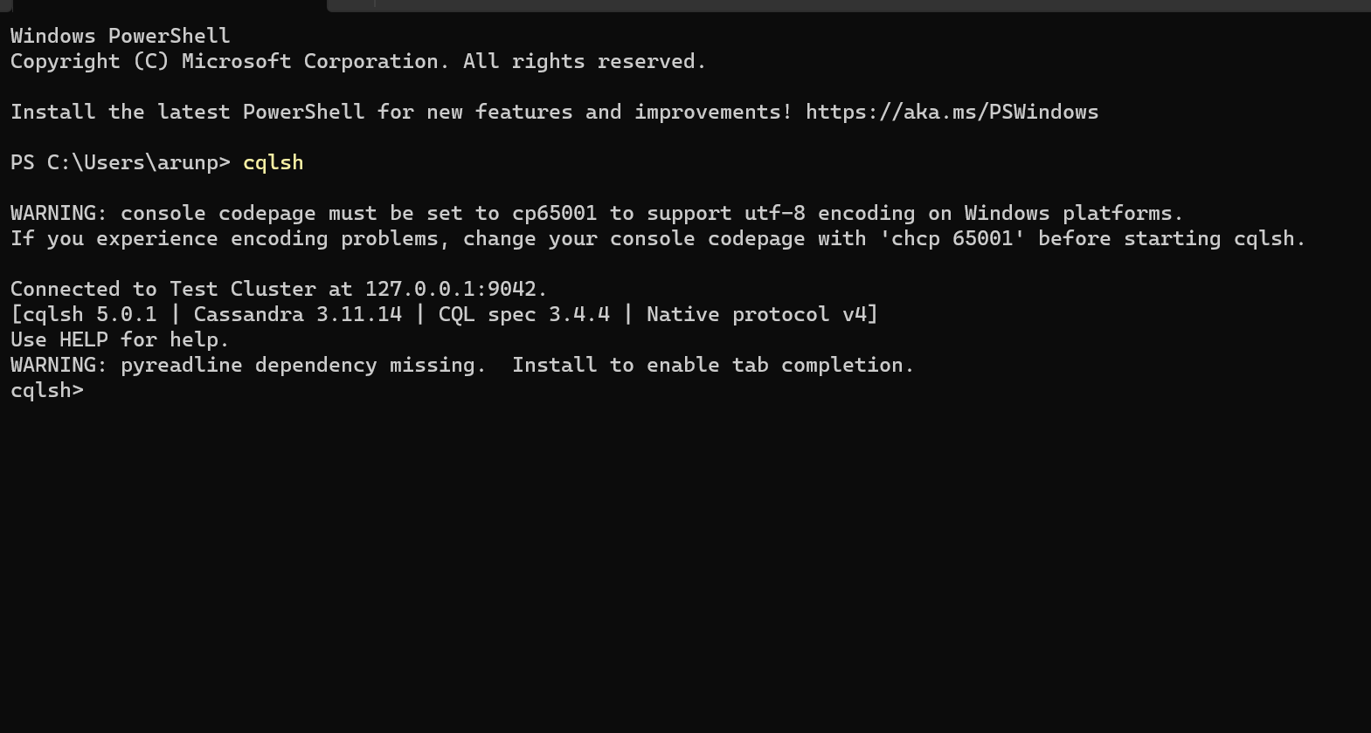
Tool
3. Cassandra

Slide 7
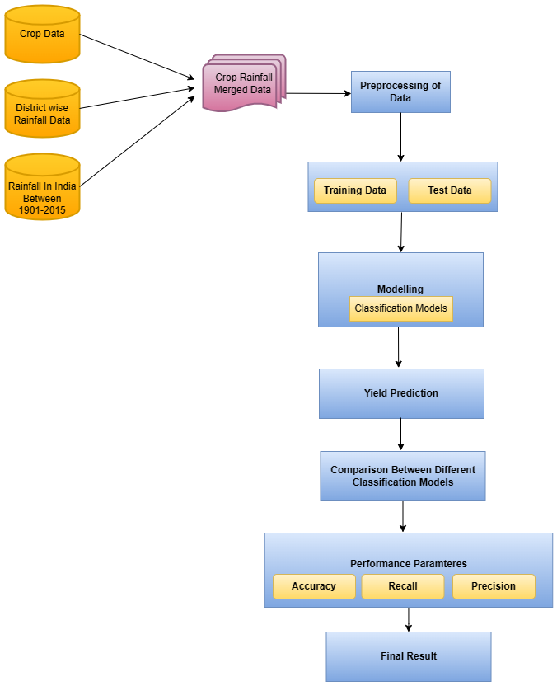
Architecture

Slide 8
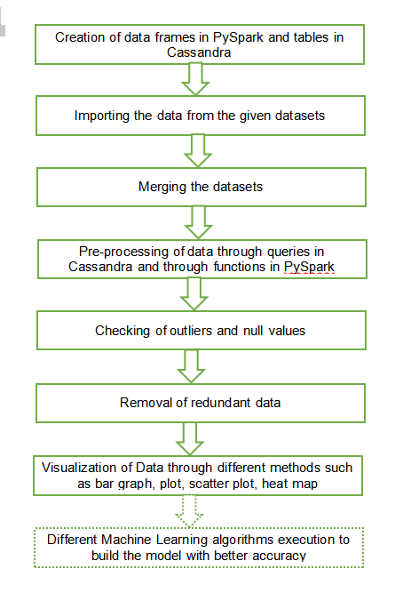
Workflow

Slide 9
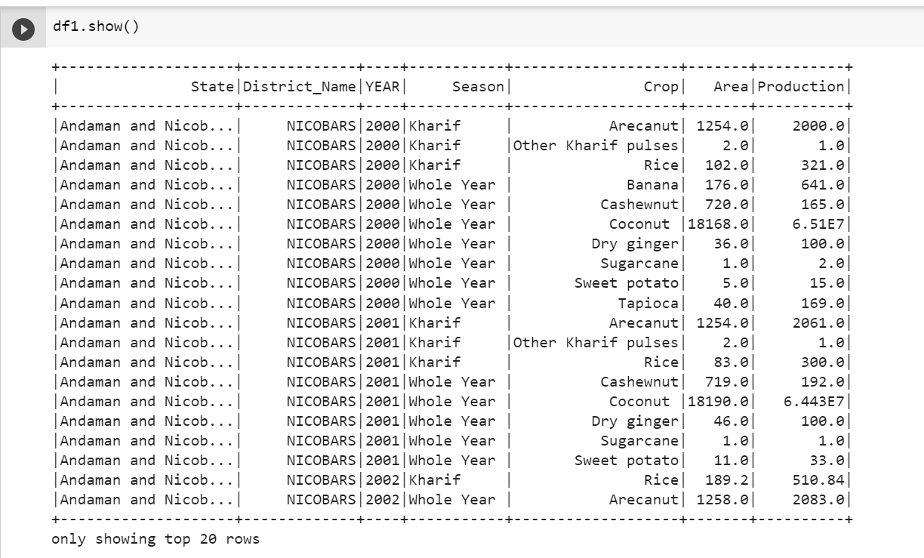
Methodology
Importing the data and creating dataframes and tables

Slide 10
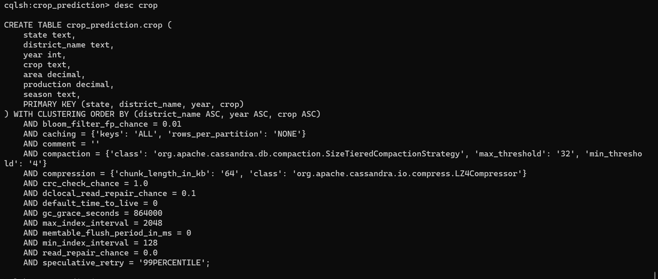
Methodology
Importing the data and creating dataframes and tables

Slide 11
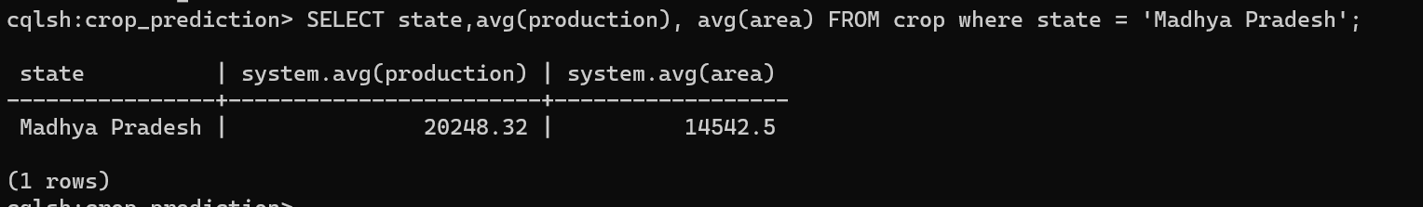
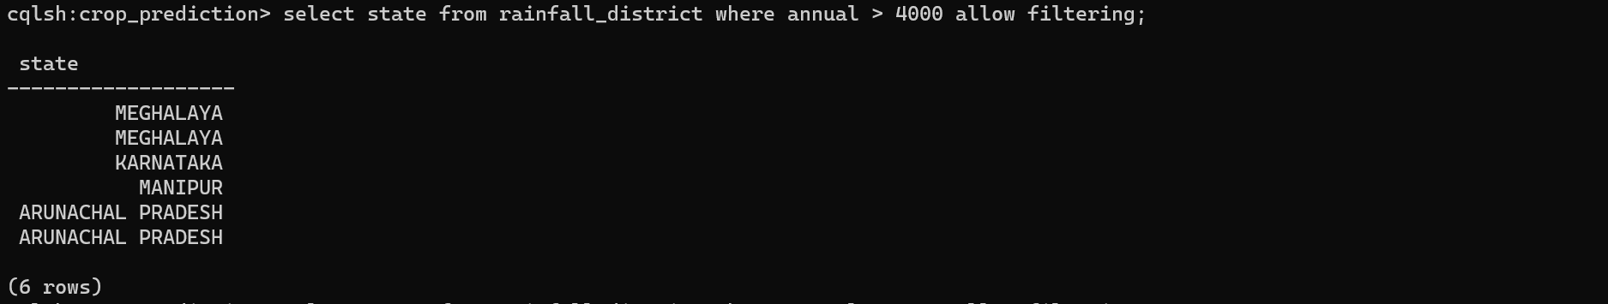
Methodology
2. Executing different queries

Slide 12
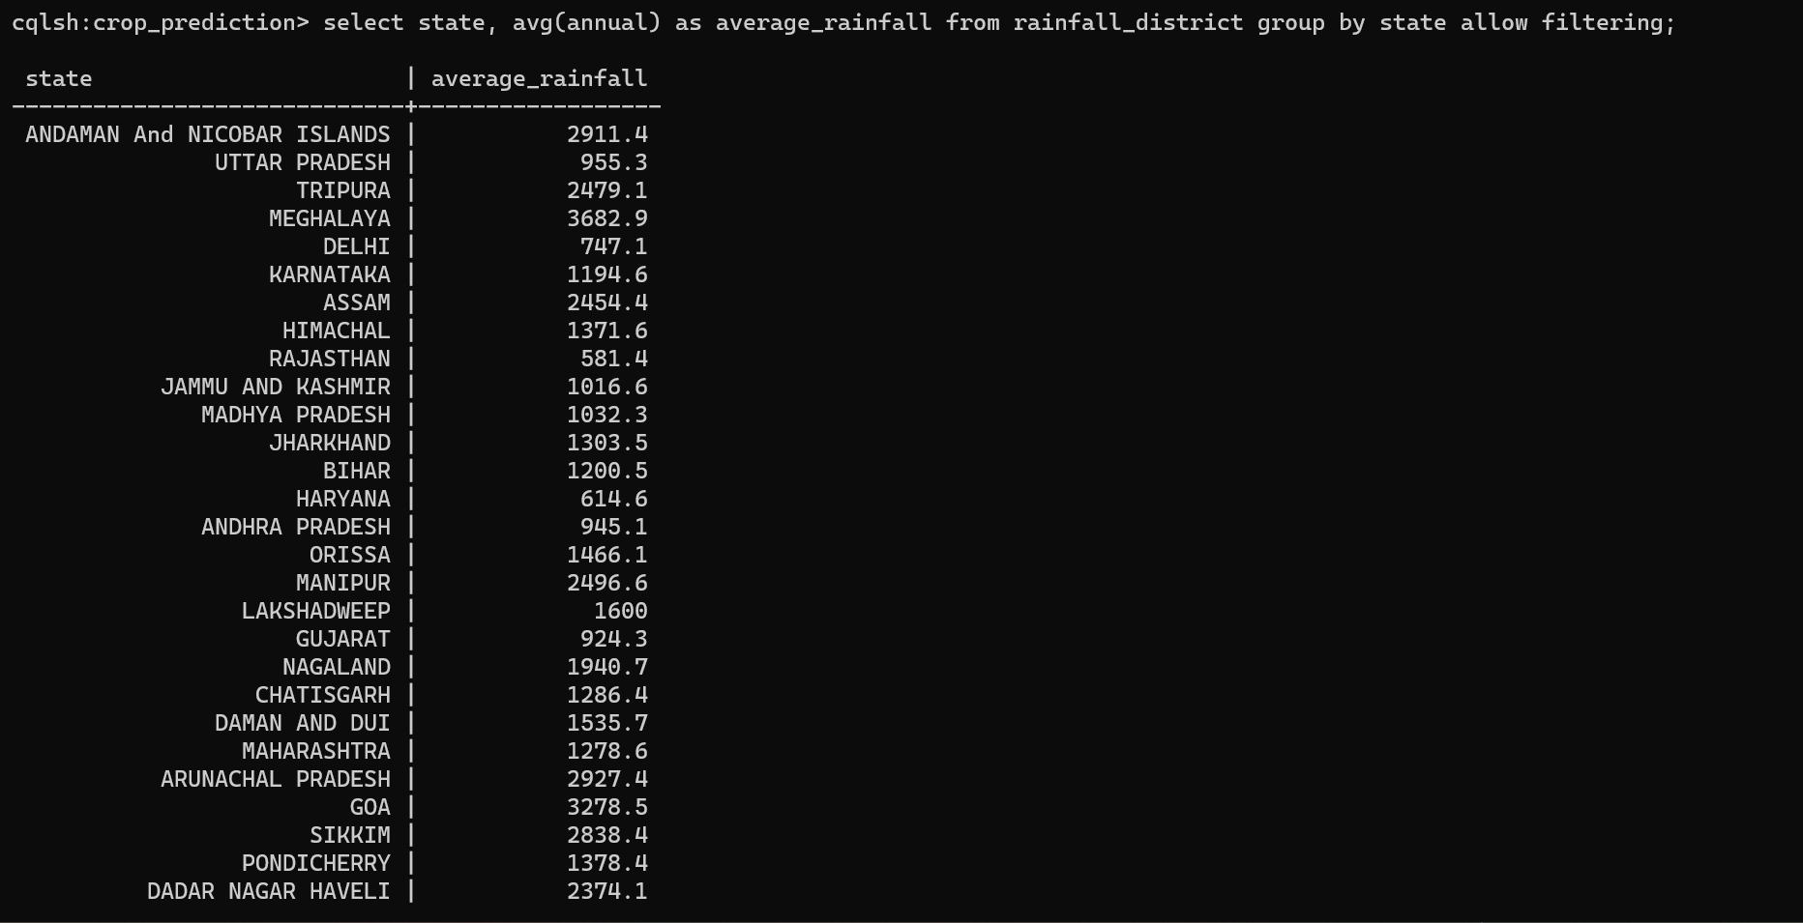
Methodology
2. Executing different queries

Slide 13
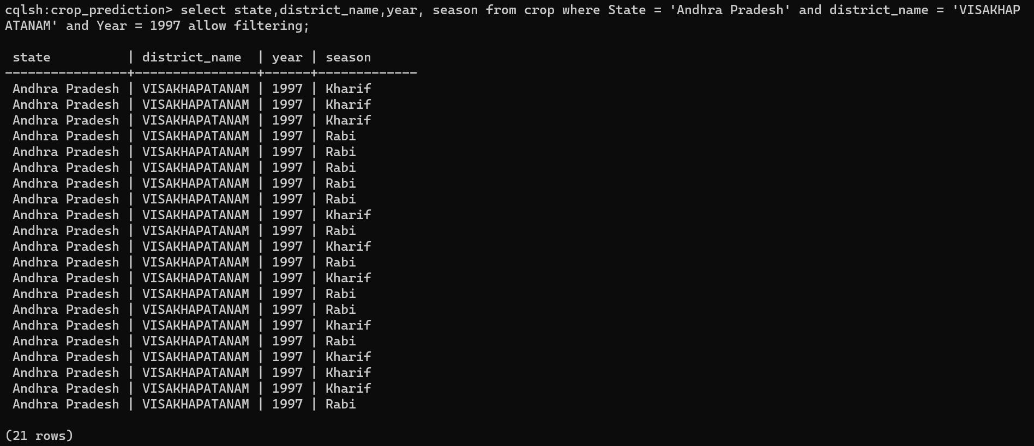
Methodology
2. Executing different queries

Slide 14
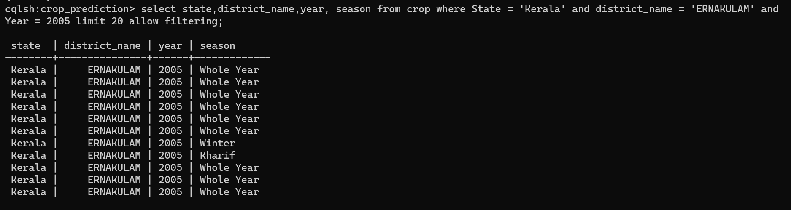
Methodology
2. Executing different queries

Slide 15
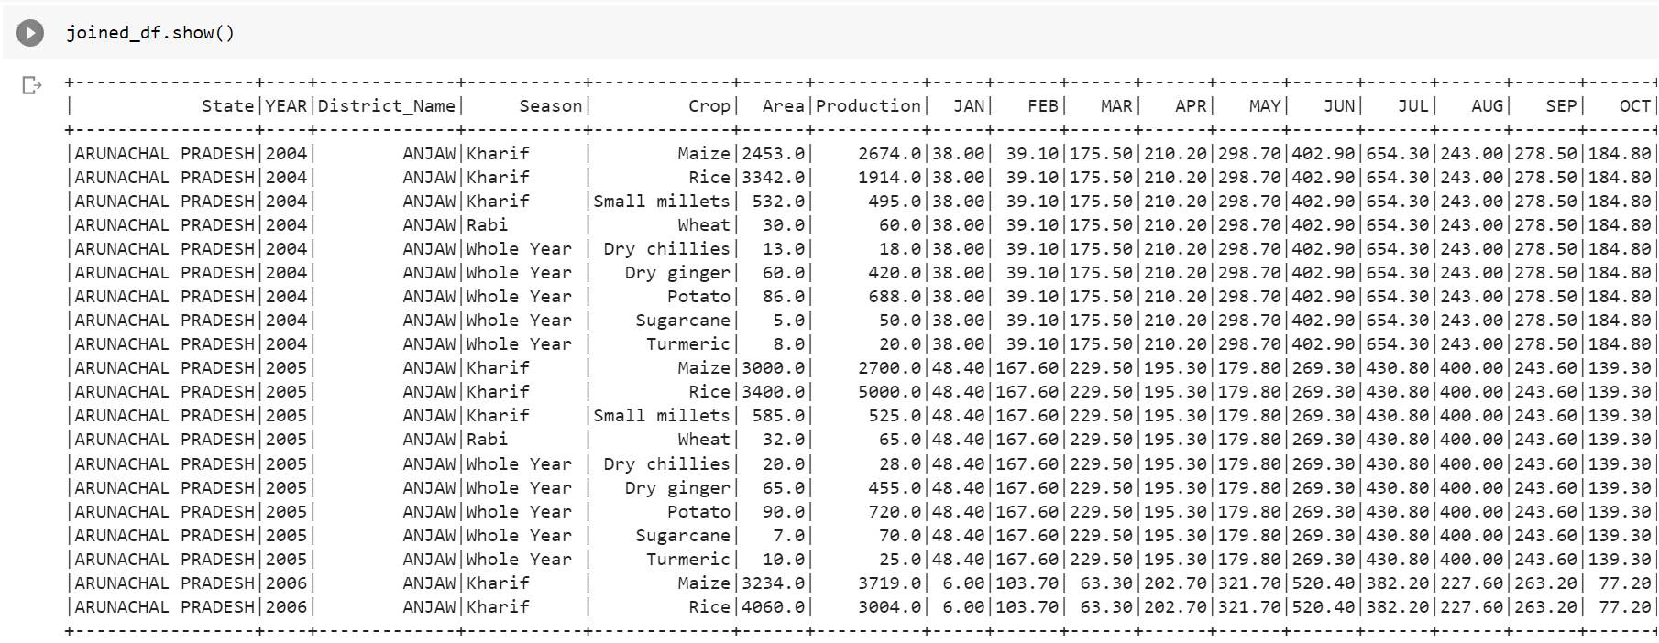
Methodology
3. Merging the data

Slide 16
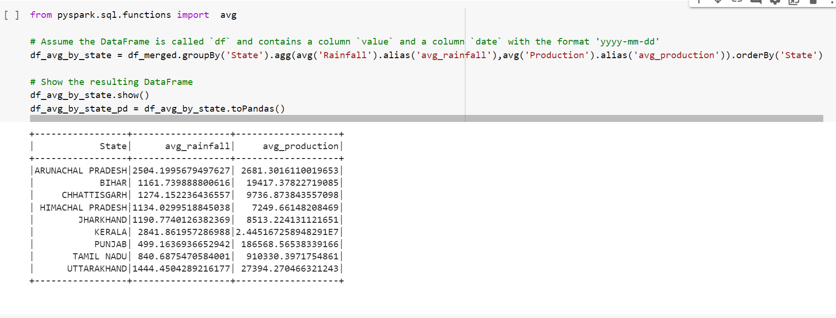
Methodology
4. Preprocessing of data

Slide 17
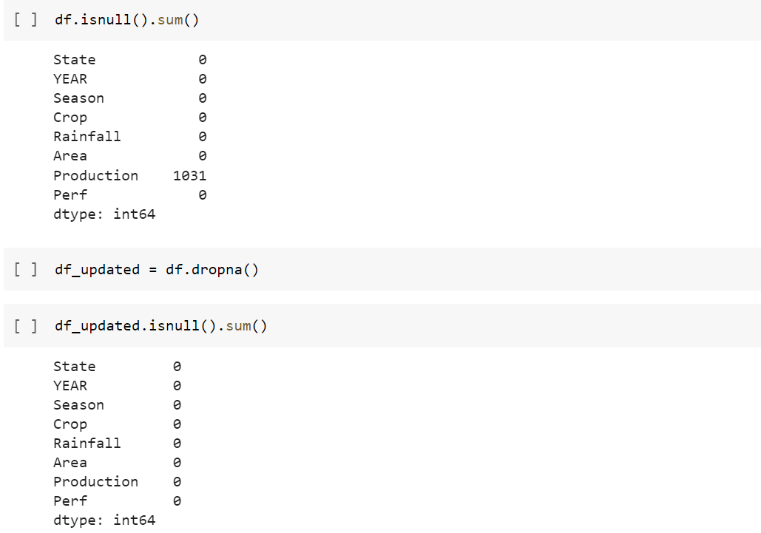
Methodology
4. Preprocessing of data

Slide 18
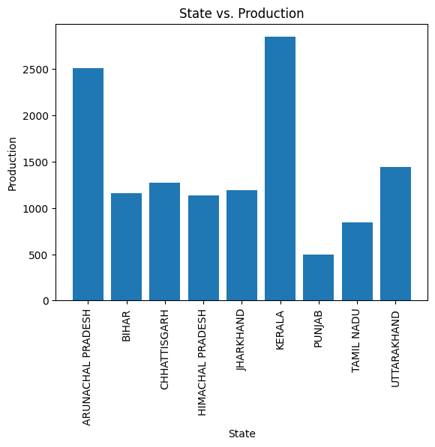
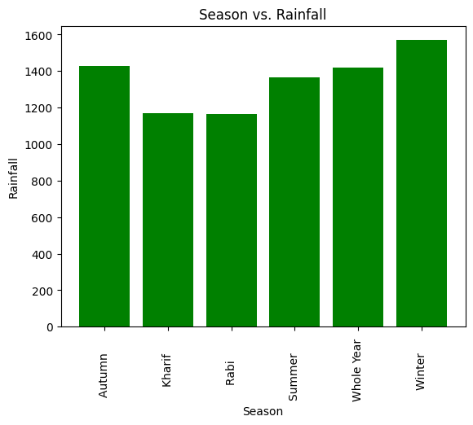
Visualization of Data
Bar Graph

Slide 19
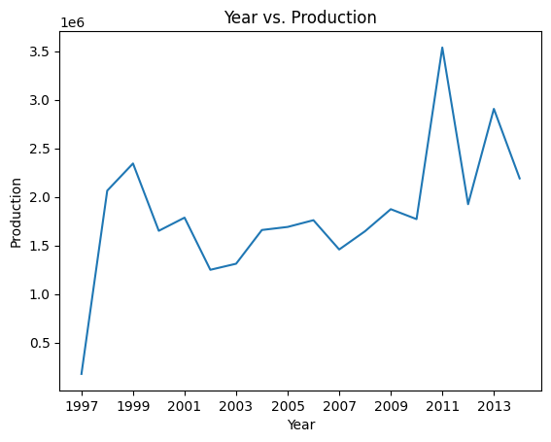
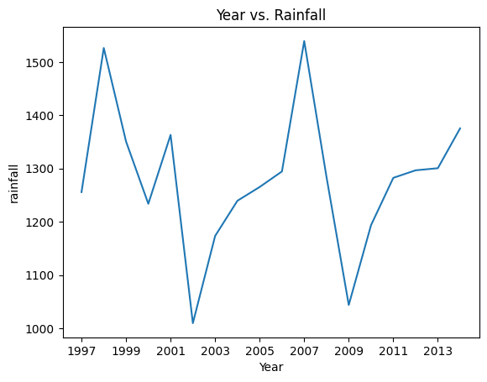
Visualization of Data
2. Plot

Slide 20
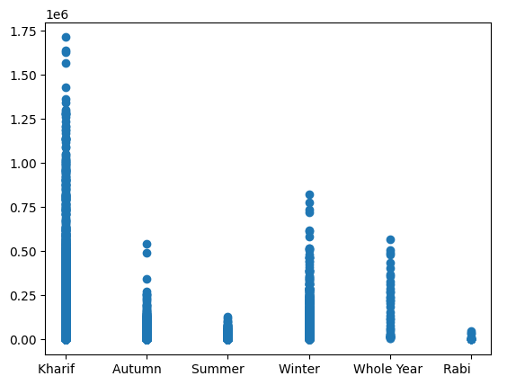
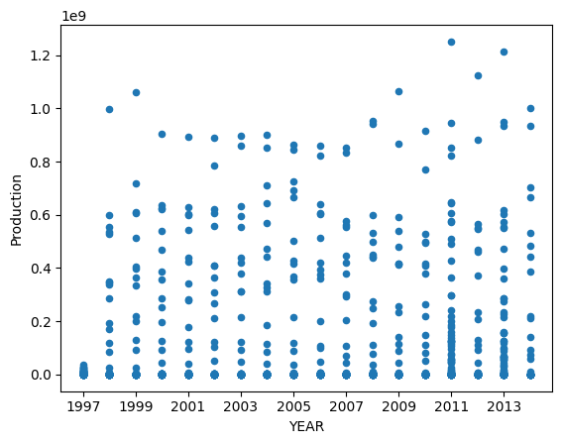
Visualization of Data
3. Scatter Plot

Slide 21
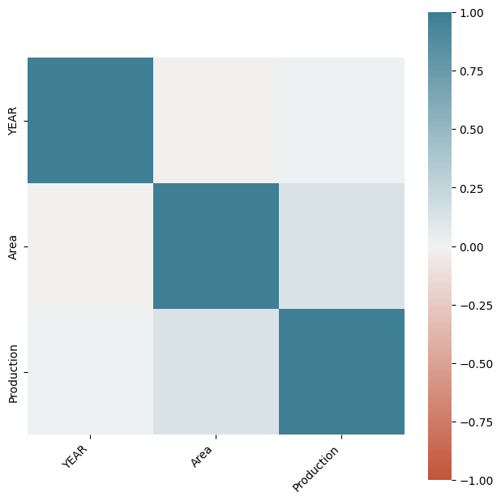
Visualization of Data
4. Heat Map

Slide 22
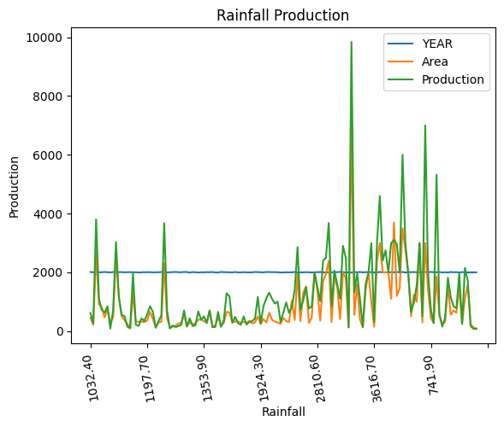
Visualization of Data
5. Group by plot

Slide 23
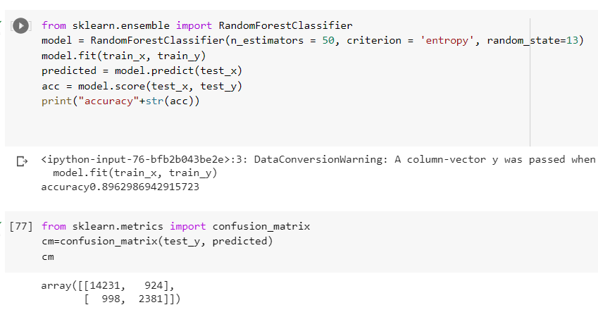
Machine Learning Implementation

Slide 24
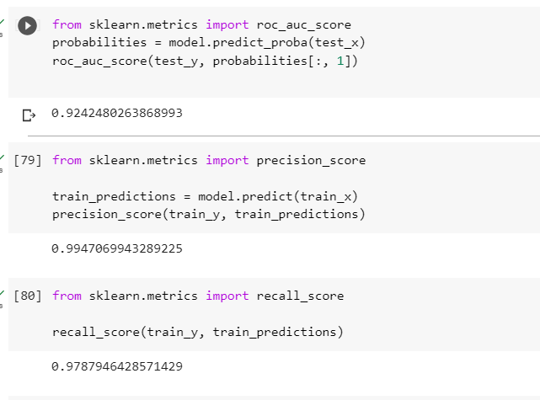
Machine Learning Implementation

Slide 25
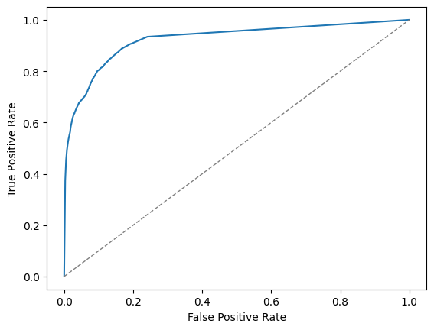
Machine Learning Implementation
ROC Curve

Slide 26
Thank You

